Slide 1
XML
Introduction to XML Parsers
LEVEL – PRACTITIONER

Slide 2
About the Author
Created By: | Shanmu (105110)
Credential Information: | Sr Architect.
Version and Date: | 1.0, November 22’nd 2011
Cognizant Certified Official Curriculum
Notes:
For the animators:
This screen content needs to be rendered in the flash, no animations needed.

Slide 3
Session Objective
After completing this chapter you will be able to understand:
What is a XML parser?
Different types of parsers.
Basics of SAX parser.
How to develop a DOM parser.

Slide 4
What is XML parser?
XML Parsers are software API’s used for
Parsing XML files and retrieving data from the XML elements.
Creating XML files programmatically.
Example:
Web.xml – is a configuration file for web application deployment.
The application server will use XML parsers to parse the web XML and read the configuration details.
The values you configure through the administration console is written back into the web XML file.

Slide 5
Types of XML Parsers
Java API is bundled with two flavors of parsers,
Parsers
SAX
DOM
SAX stands for Simple API For XML.
This is a event driven API for parsing XML.
DOM stands for Document Object Model.
This process XML as objects. Elements are translated to objects.

Slide 6
What is a SAX Parser?
SAX is an event-driven API to parse an XML document.
Whenever the parser encounters a element it generates a event and sends it to the application to respond to the event.
Few events:
Start Document - This event is fired when reading the beginning of the XML.
End Document – This event is fired when reading the end of the XML.
Start Element – This event is fired when the parser encounters a start tag of a element.
End element – This event is fired when the parser encounters a end tag of a element.

Slide 7
SAX Parser – How it works
Assume that the red arrow represents the parser execution
Start Document Event triggered and sent to application.
<?xml version="1.0"?
<Fruit>
<Apple>
……..
…….
……..
</Apple>
</Fruit>
Application
End element Event triggered and sent to application.
Start element Event triggered and sent to application.
Similarly the start and end tag element will be triggered for the <Apple> </Apple> tag too.

Slide 8
A Dive into SAX Parser
SAX does not read the entire XML document into memory.
It reads only a small chunk of document at a time, parses it, generates events, and then reads another small chunk of document.
Therefore, a SAX parser does not require large amount of memory.
SAX parser can be applied to read an XML document and retrieve the content.
SAX parser CANNOT be applied to modify an XML document.

Slide 9
When to go for SAX?
Since it consumes less memory this can be used to parse large XML documents..
Applications where memory is limited.
Used when applications is required to read data without modifying the content.

Slide 10
DOM Parser
DOM Stands for Document Object Model.
This parser uses the XML DOM model for processing XML.
XML DOM defines standard set of objects for creating XML’s.
XML DOM is a W3C standard.
It is platform and language independent.

Slide 11
DOM Parser
The XML documents are represented as nodes, all the below are represented as nodes,
Elements
Attributes
Text (content)
The attributes are represented as attribute node
The content are represented as text node
<?xml version="1.0"?
<Fruit>
<Apple description=“fruit”> USA Apple</Apple>
</Fruit>
The entire XML are represented as Document Node
The tag elements are represented as element node.

Slide 12
DOM Tree
The nodes in an XML document forms a tree structure called node tree or document tree.
The tree starts with the document node and continues to branch out until it has reached all text nodes at the lowest level.
The terms “parent” and “child” are applied to describe the relationships between nodes.
Some nodes have children and some do not have children.
Nodes without children are called leaf nodes.

Slide 13
DOM Tree Nodes
In a node tree, the top node is called the root or root node or root element.
Every node, except the root node has exactly one parent.
The root node does not have a parent.
A node can have any number of children.
Siblings are nodes with the same parent.

Slide 14
Dom Tree Illustration
Document
Node
Element
node
Attribute
node
Text
node
<?xml version="1.0"?
<Fruit>
<Apple Description=“fruit”> USA Apple</Apple>
</Fruit>
Represented as
Referred to as
root node
Description =“fruit”
XML Document
Node
Fruit
Apple
Referred to as Leaf Nodes
USA Apple

Slide 15
DOM Vs SAX
SAX | DOM
SAX does not read the entire XML document into memory. | DOM loads the entire XML into the memory
SAX parser are suitable for reading large XML’s | DOM is ideal for smaller XML’s.
SAX parsers cannot modify content of XML | DOM parser can modify and read data from XML files.
SAX is not a W3C standard. | DOM is a W3C standard.

Slide 16

Time To Reflect
Associates to reflect the following topics before proceeding.
What are SAX parsers?
What are DOM Parsers?
What is the advantage of DOM over SAX parser?
Can a node have many children?
What is a sibling and leaf node in a DOM tree?

Slide 17
Steps to parse XML using DOM parser
Step 1: Set the classpath for the DOM objects and the DOM parser classes.
The DOM parsers - org.apache.xerces.parsers.*
The DOM tree objects - org.w3c.dom.*
The DOM parsers will be available in Xerces*.jar
The Dom tree objects will be available in XML-apis.jar.
Step 2: Develop a program and import the above mentioned packages.

Slide 18
Steps to parse XML using DOM parser
Step 3: Load the XML file in the program as follows,
DOMParser parser = new DOMParser();
parser.parse(“fileName”);
FileName- Represents the absolute/relative path followed by the XML file name.
Step 4: Retrieve the XML document object as follows,
Document doc = parser.getDocument();

Slide 19
Steps to parse XML using DOM parser
Step 5: Get the list of nodes ( element, text, attribute) as follows,
NodeList nodeList = doc.getElementsByTagName(“<Tag name>");
Step 6: Iterate through the node list to get the node name and the content as follows,
for (int i = 0; i < nodeList.getLength(); i++) {
Node node = nodeList.item(i);
String nodeName = node.getNodeName();
String nodeText = node.getTextContent();
}

Slide 20

Lend a Hand: Lets Parse a XML using Dom Parser
Create a java project.
Configure the jars XercesImpl*.jar and XML-APIs.jar in SDE build path.
Copy the following XML in the eclipse workspace.
Develop the program illustrated in the next slide in eclipse work space and execute it.
NOTE: If the Source Code is not visible access the PPT from ELTCMS portal and develop the program.

Slide 21
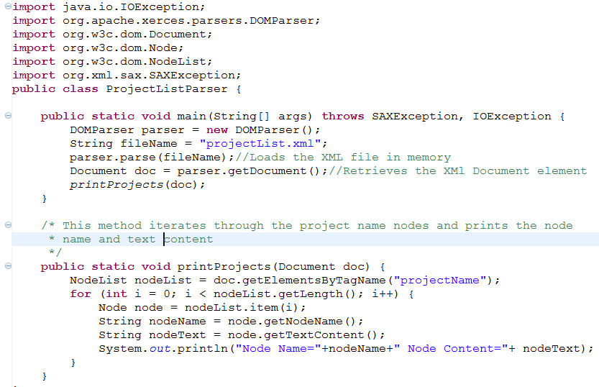
Lend a Hand: DOM Parser Sample Code

Slide 22

Hands on Exercise: DOM Parser Demo
Associates needs to develop a program which parses the given file and creates a output as mentioned.
XML File:
Expected Output:
Name Type Quantity
===== ==== =======
Cheetos Grocery 25
Levi Jeans Apparel 10
Sony Vaio Electronics 5
Hints: Use Document. getElementsByTagName() & Node.getChildNodes() API’s.

Slide 23
XML
You have successfully completed -
Introduction to XML Parsers

